Slide 1

Authentication & Authorization Project prepared by Group 2 members
HABEEB OMOTUNDE (200584861)
SETH NANA KWAME APPIAH-KUBI (200564282)
HETVI MANISHBARI BAVARVA (200565677)

Slide 2
Outline
Introduction
01
Authentication & Authorization
02
Case Study
03
ContactManager app
Web app staging and configuration
04
Deployment
05
Demo
06
Conclusion
07

Slide 3
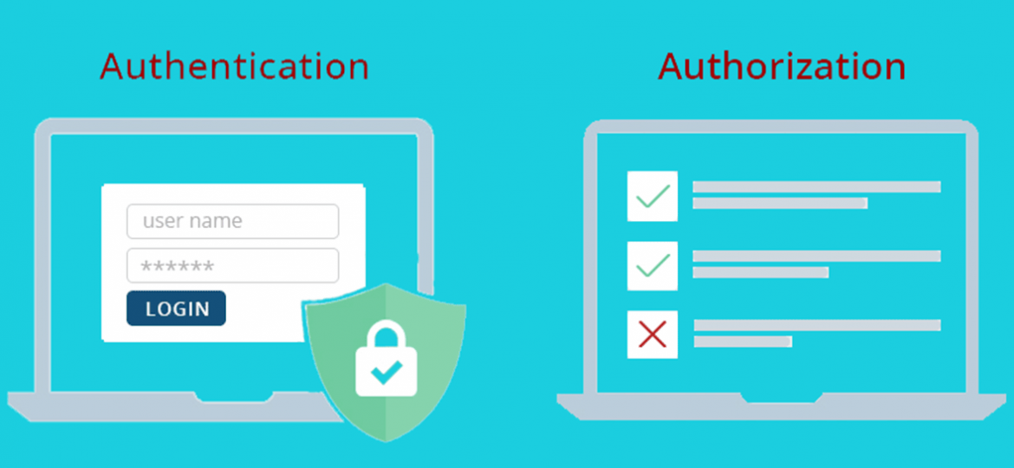
Introduction
Access to critical data in any organization or enterprise must be monitored and controlled to ensure confidentiality, Integrity and availability of data.
Administrators must also ensure user’s identity is verified before data access while enforcing access rights to confidential data/resources.
In other words,
User Identity is validated via Authentication while
Confidentiality is enforced via Authorization

Slide 4
Authentication & Authorization - Definition
Authentication is the process of verifying the identity of a user before granting access to a service. Authentication can be validated via what the user knows (login credential), what the use is (Biometric) and/or what the user has (secret token).
Authorization is the process on ensuring strict access to data or computing resources (compute, storage or processes) based on a user’s access rights or permission.
Similarities | Differences
Both are security requirements which falls under the category of non-functional requirements in requirements engineering | Authentication focuses on verifying user identity however, authorization focuses on data access rights of authenticated user(s)

Slide 5
Case Study – ContactManager App
Introduction
Contact Manager App is an ASP.NET Core web app with user data protected by authentication and authorization. The app has a modest scope with few use cases such as create contact, edit contact, approve or reject contact etc.
Features
It has 3 security groups responsible for controlling what each group member can do. These are:
Registered users: View all the approved data and can edit/delete their own data.
Managers : Approve or Reject contact data. Only approved contacts are visible to users.
Administrators: Approve or Reject and edit/delete any data. In summary, he can access all features of the app
Tools & Prerequisites
Tools - VS Studio 2022, MS SQL Server DB, MS SQL Server Management Studio,
Prerequisites – Knowledge of ASP.Net Core, Entity Framework Core, C#
Notes:
To demonstrate these two concepts, We will share a case study which involves the deployment of a web app called Contact Manager

Slide 6
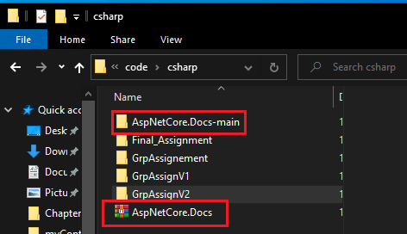
App Setup & Configuration – Step 1
Download the starter app from https://codeload.github.com/dotnet/AspNetCore.Docs/zip/main and unzip the AspNetCore.Docs-main.zip file

Slide 7
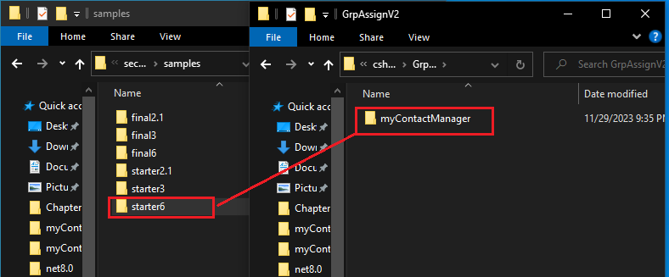
App Setup & Configuration – Step 2
Navigate to the samples directory “.\AspNetCore.Docs-main\AspNetCore.Docs-main\aspnetcore\security\authorization\secure-data\samples” where the starter app is located, copy starter6 folder to the desired directory and rename folder to myContactManager.

Slide 8
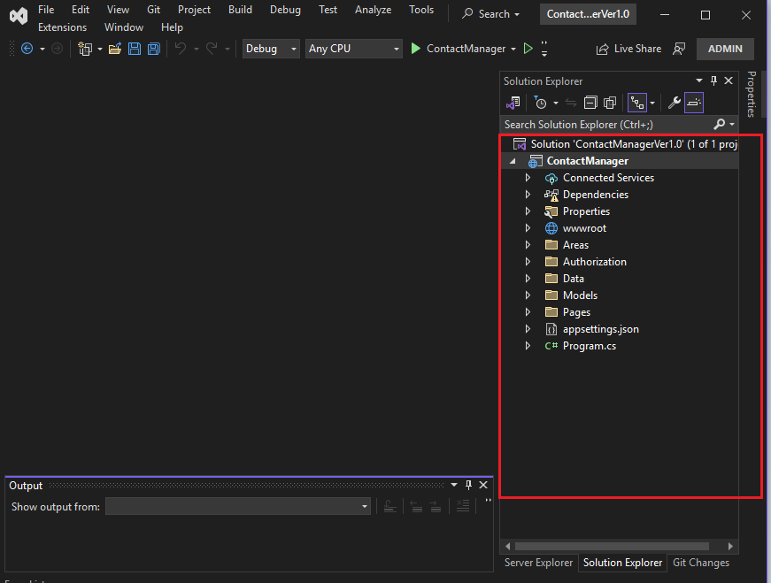
App Setup & Configuration – Steps 3/4
3. Open Visual Studio 2022 and load the Contact Manager solution, “Contactmanager.sln”
4. The packages listed below are needed for the solution to work.
Microsoft.EntityFrameworkCore.SqlServer
Microsoft.EntityFrameworkCore.Tools
Microsoft.AspNetCore.Identity.EntityFrameworkCore
Microsoft.AspNetCore.Authentication.JwtBearer
However, the Contact manager starter app comes preloaded with these packages hence there’s no need to reinstall

Slide 9
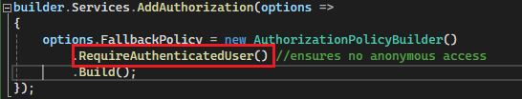
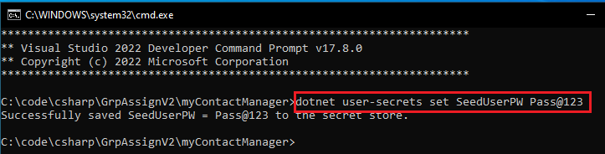
App Setup & Config - Authentication
1. Set the fallback authorization policy to require users to be authenticated. This will make sure any user who intends to access the app must be authenticated.
2. Set the seeduser password (SeedUserPW) using the secret manager tool on VS studio 2022. This will serve as the password of the 2 initialized accounts in the app (manager@contoso.com & admin@contoso.com)

Slide 10
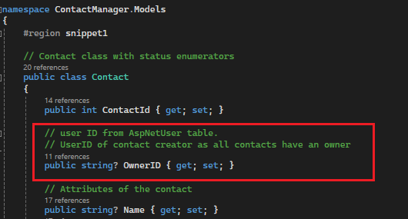

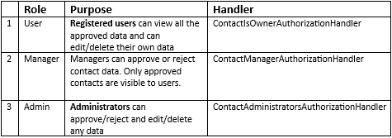
App Setup & Config - Authorization
1. Associate every contact object to an owner to prevent unauthorized access in the Contact model
2. Next, enable Role-Based Authorization by adding Role services to each identity using the AddRoles() method of the IdentityBuilder class. This is because when a new user is created, it may belong to one or more roles. The table below summarizes the roles and their respective handlers.

Slide 11
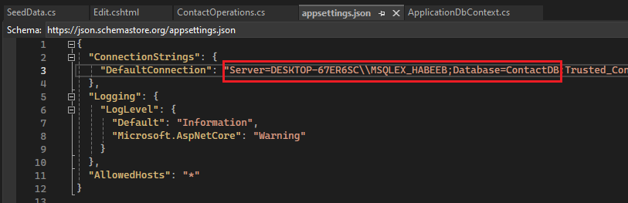
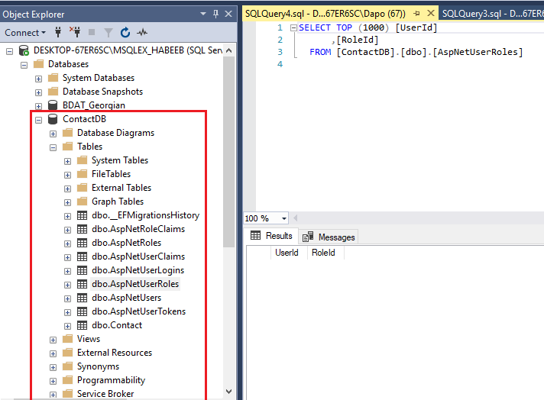
App Setup & Config – Database setup
1. To set us the Database, Set the necessary parameters in appsettings.json to point to the appropriate SQLServer and provide the database name
2. From the package manager console, run these two commands to create the Database using the settings in appsettings.json:
add-migration Contact1
update database

Slide 12
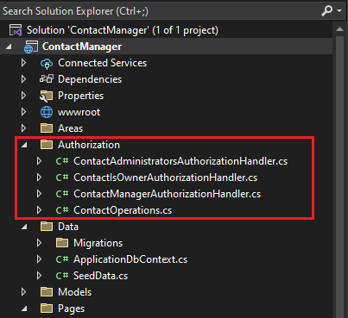
App Setup & Config – Handler setup
Create owner, manager, and administrator authorization handlers in Authorization folder. Each handler is responsible for the access rights of the roles in the table below. After creation, all handler must be registered with the service collection.
builder.Services.AddScoped<IAuthorizationHandler, ContactIsOwnerAuthorizationHandler>();
builder.Services.AddSingleton<IAuthorizationHandler,ContactAdministratorsAuthorizationHandler>();
builder.Services.AddSingleton<IAuthorizationHandler,ContactManagerAuthorizationHandler>();

Slide 13
App Setup & Config – Contact Operations
1. The set of allowable operations in the Contact Manager App are configured in ContactOperations class under ContactManager.Authorization namespace. These are:
Create
Read
Update
Delete
Approve and
Reject
Admin and Manager roles are also defined in this module.

Slide 14
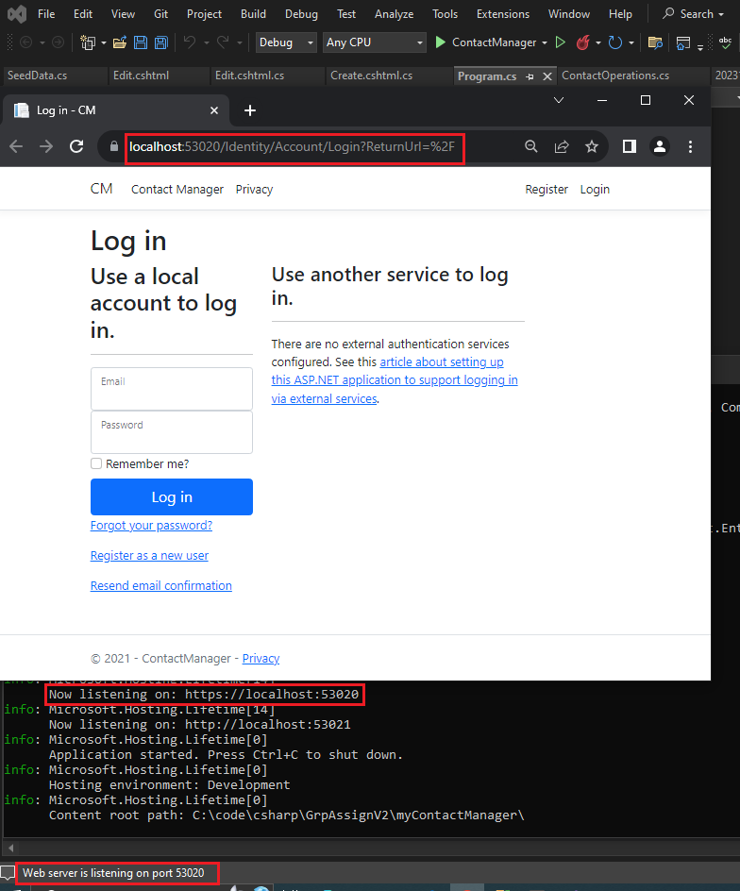
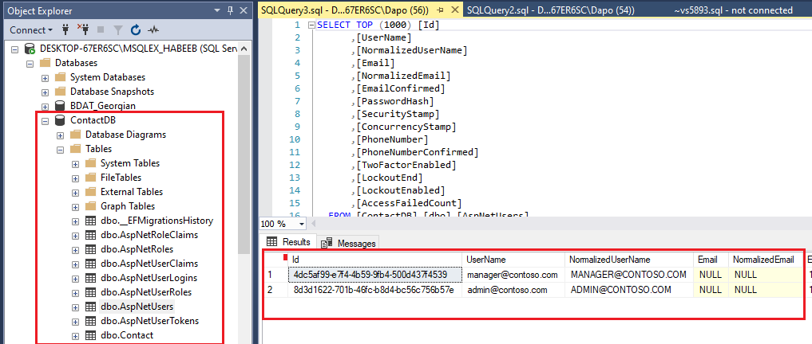
Deployment
Build & run the completed application.
Ensure a strong password is set with the Secret Manager tool
Before starting the application, ensure the Microsoft SQL server is running.
Note the two user records created and inserted into the dbo.AspNetUsers table on ContactDB. These are the manager and administrator users.
Users inserted inro table AspNetUsers after running the starter App
Running the App with server listening on port 53020

Slide 15
Demo
Scenarios
User Login – manager login
User Registration – a new account is registered by a new user
Contact creation – the new user creates a contact
Contact approval – manager approves the contact
Approval Override – Admin reviews and overrides manager’s approval.

Slide 16
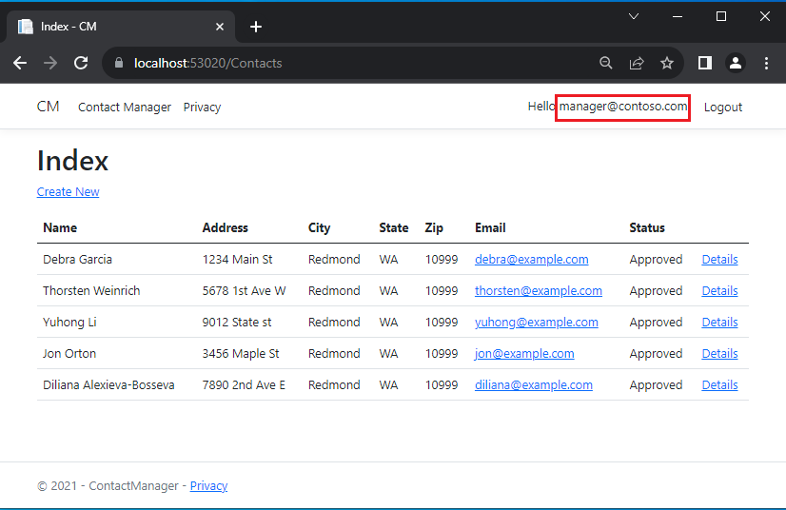
Demo - manager login

Slide 17
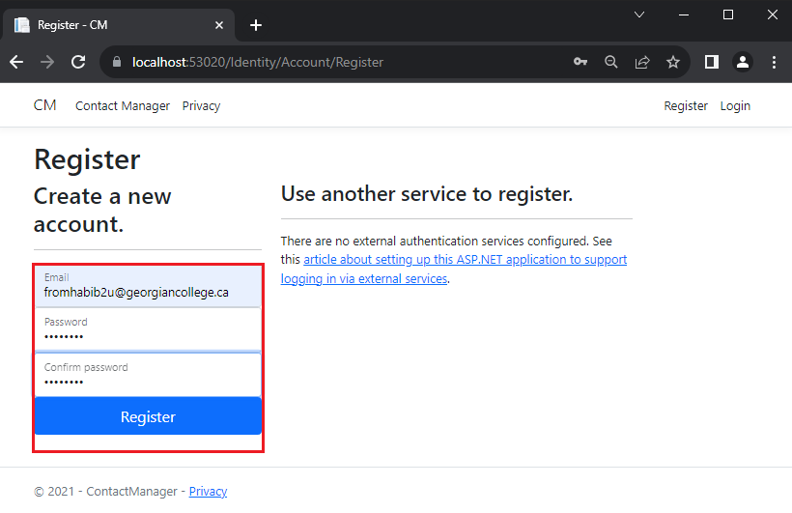
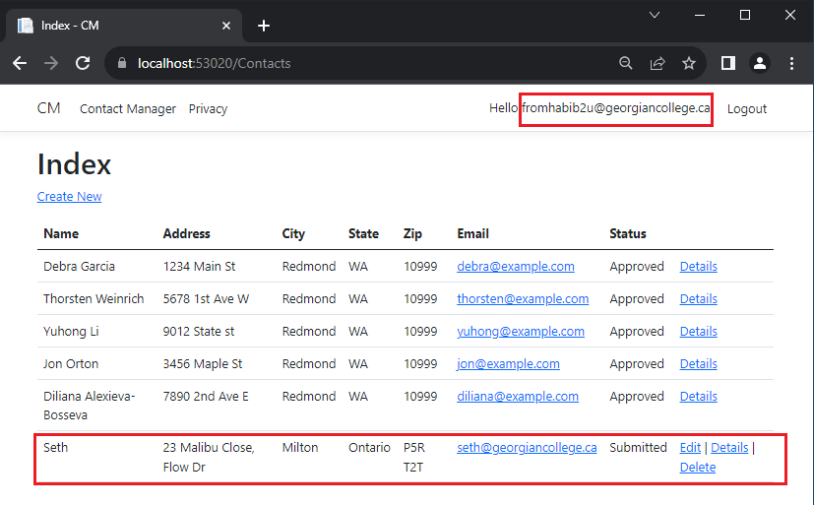
Demo – User Registration & Contact creation
In the next scenario,
A new user (fromhabib2u@georgiancollege.ca) will be registered and record will be inserted into the database.
The user will create a contact ,as highlighted in the figure below which will appear on manager’s console requesting approval or rejection. Also, only the newly created contact displays edit, details and delete links.

Slide 18
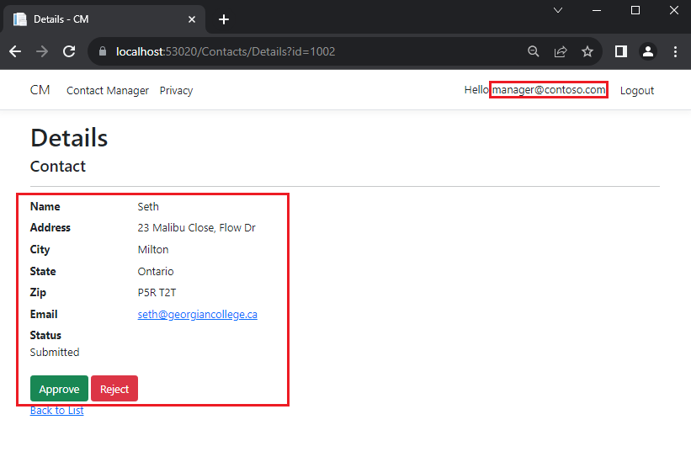
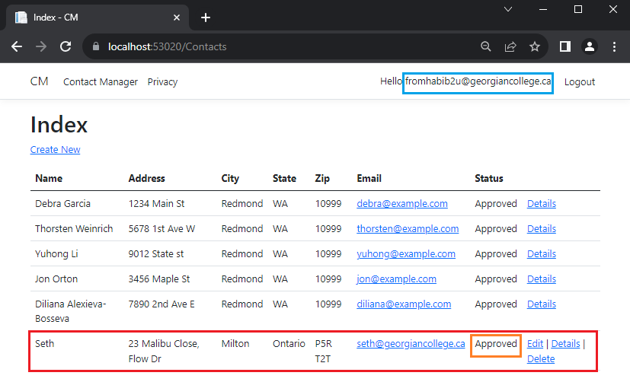
Demo – Approval request by new user
Manager can view detail of submitted contact & either approve or reject it. In this case, contact is approved.
When the new user views it as seen in the figure below, the status has changed from Submitted > Approved.

Slide 19
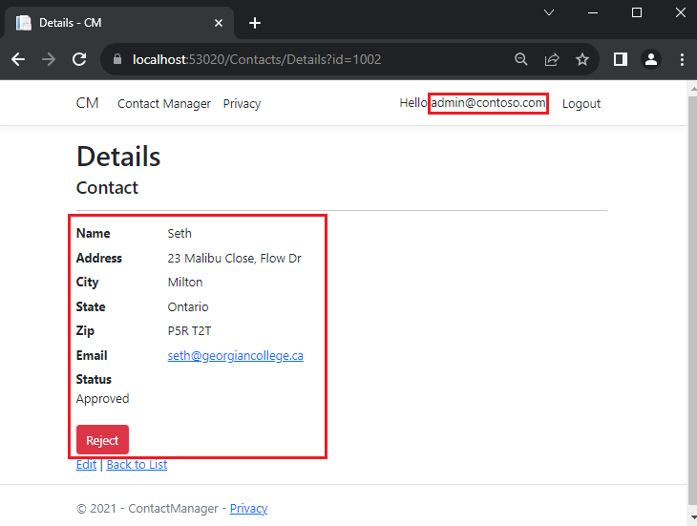
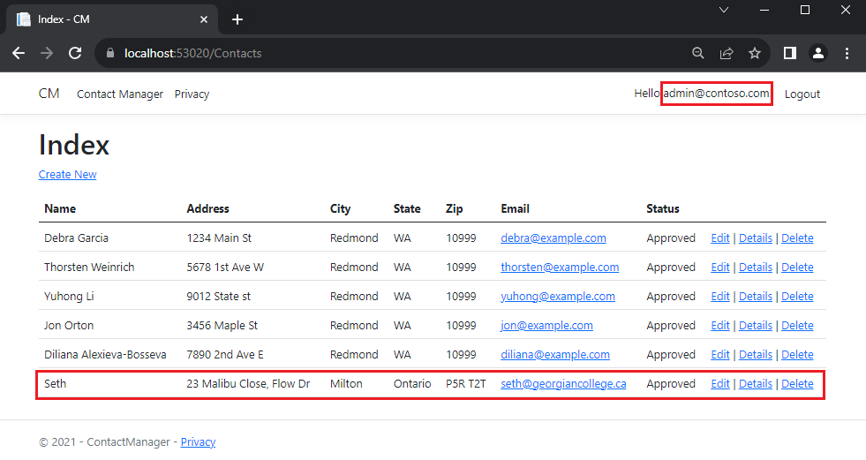
Demo – Approval Override by Admin
Admin will be able to review approval, view details, edit or delete contact to demonstrate their different access rights. In this case he decides to override the manager’s approval and reject the contact.
Approval rejected by admin.

Slide 20
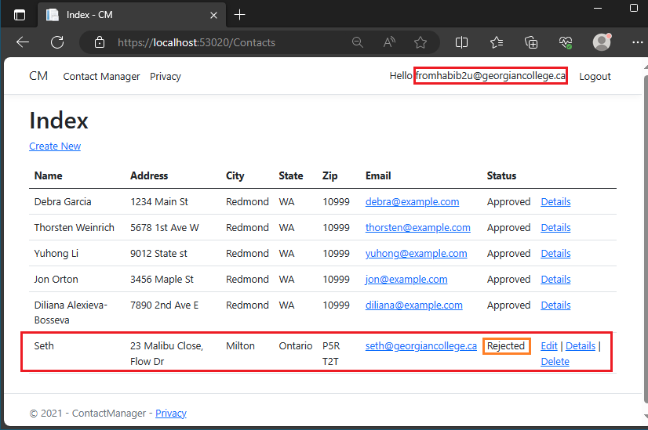
Demo – New user contact status updated
When the new user views it as seen in the figure below, the status would have changed from Approved > Rejected.

Slide 21
Conclusion
In summary, the sample Contact Manager App has been used in demonstrating authentication and authorization in securing user data and enforcing confidentiality. As a recap, the starter app has 3 security groups namely, a registered user, manager and admin. Their respective access right are summarized below:
Registered users can view all the approved data and can edit/delete their own data.
Managers can approve or reject contact data. Only approved contacts are visible to users.
Administrators can approve/reject and edit/delete any data.
Finally, It’s important to mention that the group would have loved to implement a feature named delegate where a new or existing user in the ContactDB can be promoted to an administrator or manager. This role can only be executed by the Administrator

